Slide 1
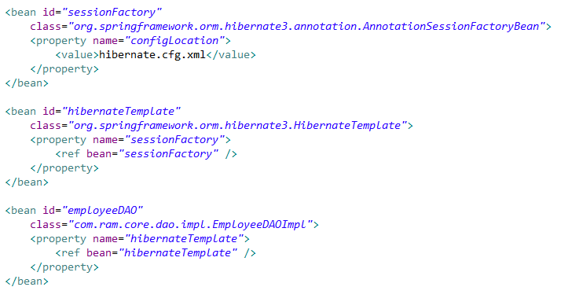
AnnotationSessionFactoryBean in Spring
AnnotationSessionFactoryBean class belongs to the package org.springframework.orm.hibernate3.annotation.
AnnotationSessionFactoryBean is used to create session factory if hibernate pojo are annotated. configLocation is the property to which we assign hibernate.cfg.xml. This session factory is assigned to hibernate template to do database transaction.
In the below code we can see that bean sessionFactory has been created with AnnotationSessionFactoryBean class. sessionFactory has been assigned to HibernateTemplate and hibernateTemplate bean has been assigned to employeeDAO bean. Now inside EmployeeDAOImpl we do database transaction.

Slide 2
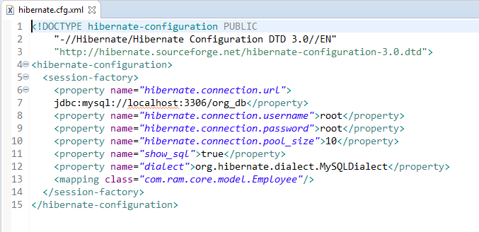
AnnotationSessionFactoryBean in Spring
hibernate.cfg.xml is an XML which consists all the database configuration. Database name, POJO mapping, username, password and other database configurations has been declared in hibernate.cfg.xml.

